Slide 1


TAMILNADU COLLEGE OF ENGINEERING
Accredited by NAAC with Grade ‘A’
(Approved by AICTE & Affiliated to Anna University, Chennai)
New Heights Old Traditions
Department of Computer Science and Engineering
Project Final Review
DATE : 09.04. 2026

Slide 2
Session Based – Cloud Integrated
File Transferring Ecosystem
Project members:
Guided by:
Abineeth T M : 714222104004
Basil V Mathew : 714222104008
Inbarasu M : 714222104020
Koushick G V : 714222104029
Dr. Rajesh Babu
Head of department / CSE

Slide 3
Introduction
In the modern digital era, secure and efficient sharing of confidential documents has become a critical requirement for individuals, organizations, and enterprises. Traditional file-sharing methods often lack sufficient security measures, making sensitive information vulnerable to unauthorized access, data breaches, and cyber-attacks. To address these challenges, the Session Integrated Confidential Document Sharing Application is designed to provide a secure, reliable, and user-friendly platform for sharing sensitive documents. The system integrates session-based authentication and encryption techniques to ensure that only authorized users can access shared files within a limited time frame. This application enhances data confidentiality, integrity, and secure transmission, making it suitable for professional, academic, and business environments.

Slide 4
Abstract
The Session Integrated Confidential Document Sharing Application is a secure file-sharing platform that enables users to transfer sensitive documents safely using session-based authentication and encryption techniques. The system establishes a secure session between the sender and receiver, ensuring that documents are accessible only during the active session. Once the session expires, the shared files become inaccessible, thereby preventing unauthorized reuse or leakage. The application incorporates features such as encrypted data transfer, real-time device discovery, access control mechanisms, and secure storage handling. By combining these technologies, the system provides a robust solution for confidential document sharing, reducing security risks and improving trust in digital communication systems.

Slide 5
Literature Survey
Author & Year | IEEE Paper Title | Methodology / Tech
Zhang, Y. & Lee, W. (2019) | Secure Peer-to-Peer File Sharing Using End-to-End Encryption | End-to-End AES Encryption RSA Key Exchange Peer-to-Peer Communication Model
Kumar, S. & Patel, R. (2020) | Session-Based Authentication for Secure Data Transmission | Session Tokens Time-Limited Access Control HTTPS Secure Communication
Chen, L. et al. (2021) | Secure Mobile File Sharing Using WiFi Direct | WiFi Direct Peer Discovery Encrypted Socket Communication Android-Based Implementation

Slide 6
Proposed Method
Session based file transfer
Cloud integration
User authentication
Data set shared via QR
Session maintained by multilevel security

Slide 7
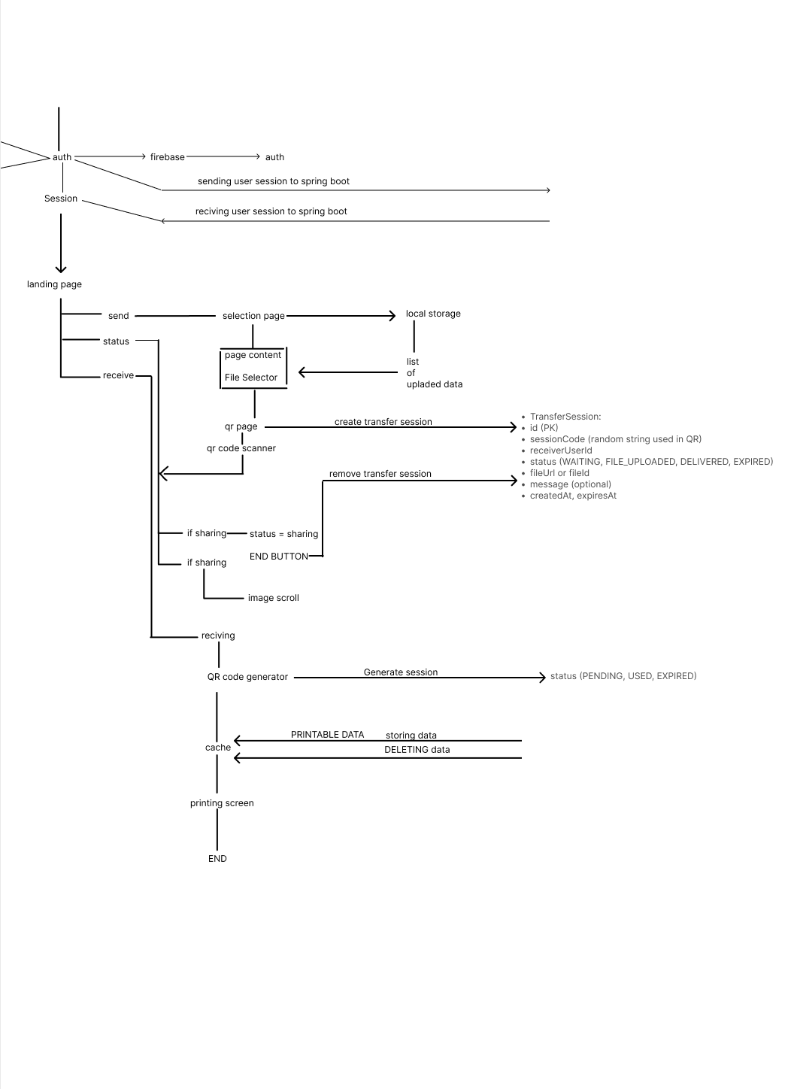
Flow Chart

Slide 8
Tools And Methodology Used
SpringBoot : Backend and api management
Android :Main application interface
Render : Backend hosting
Supabase : Datamanagement
Android Studio: Android app development
Spring tools : Backend development

Slide 9
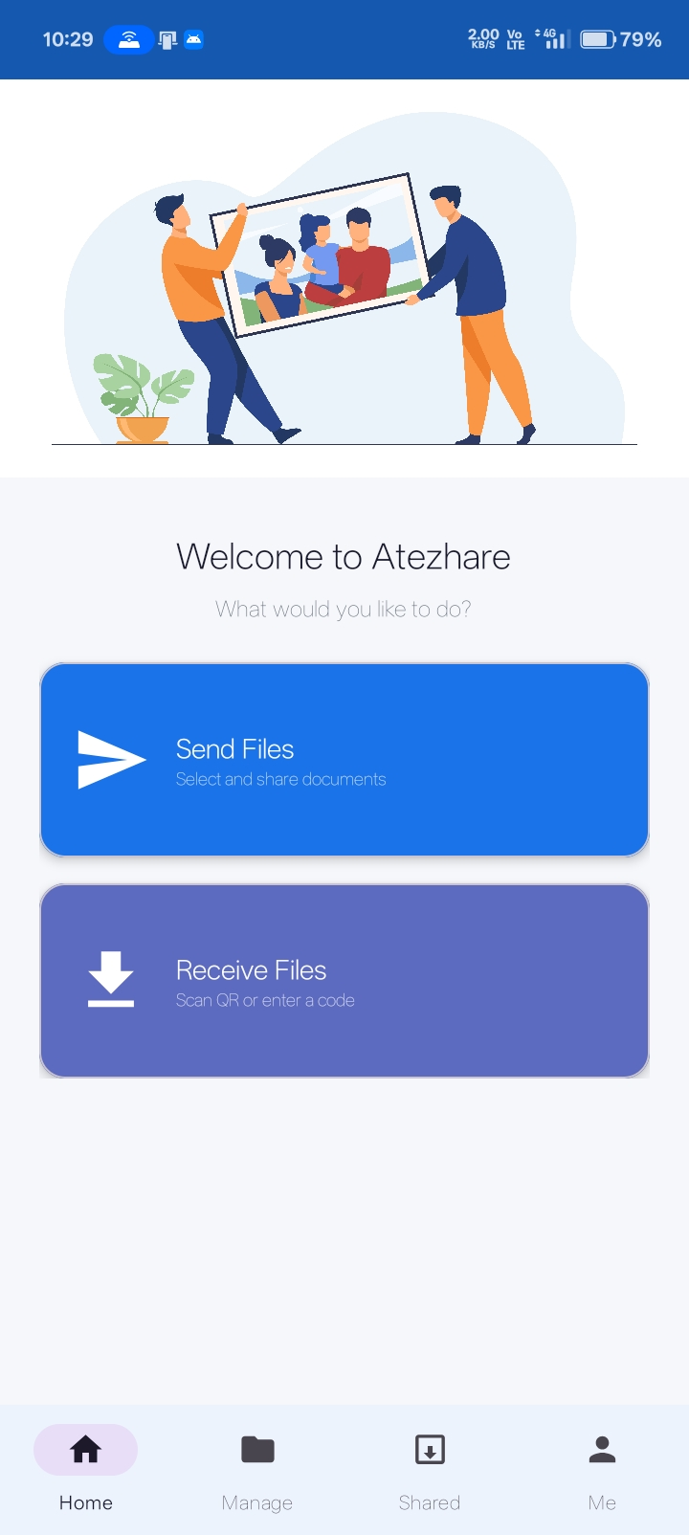
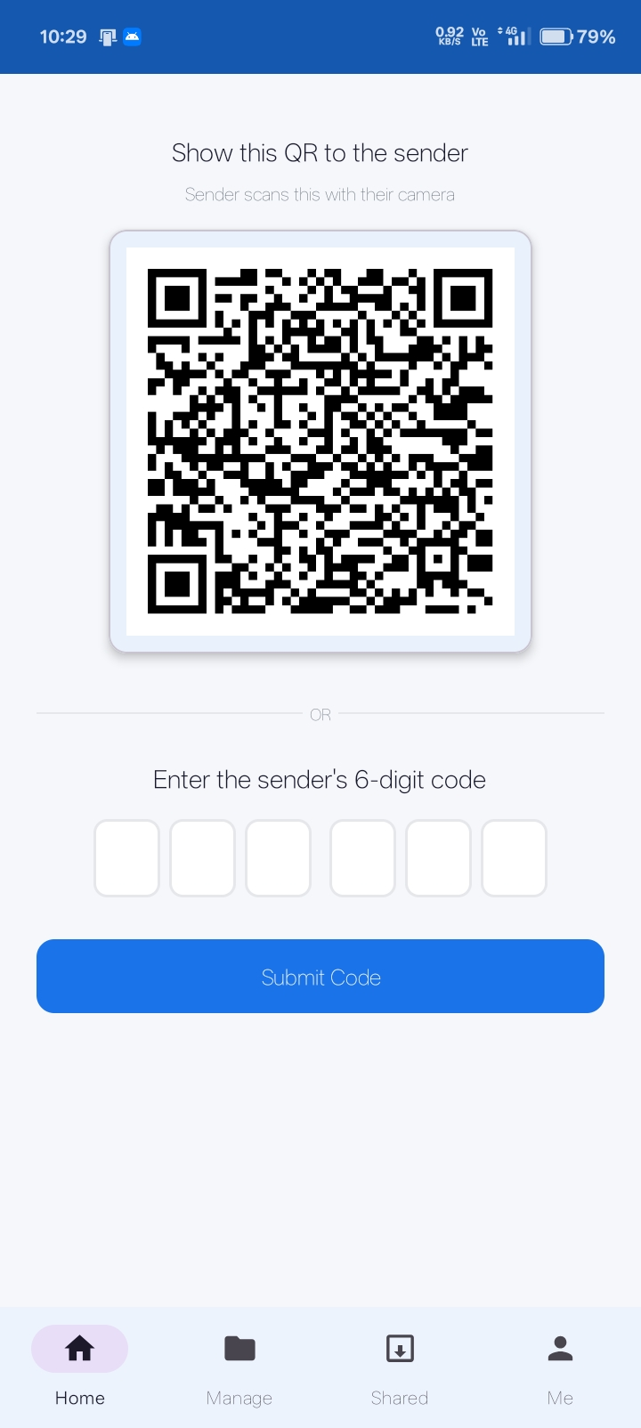
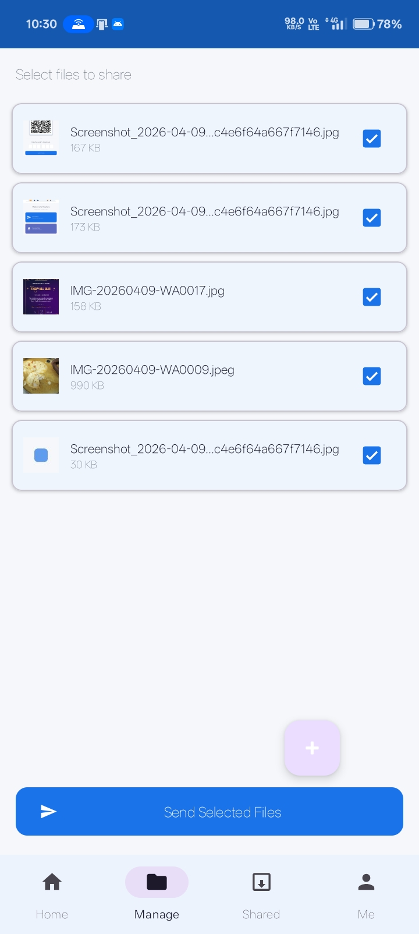
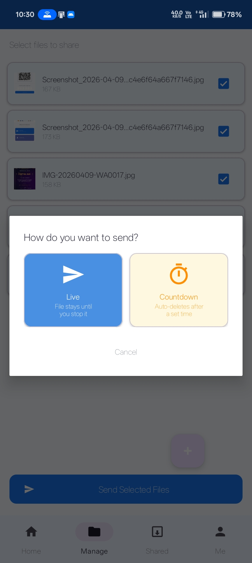
Simulation And Implementation

Slide 10
References
William Stallings, Cryptography and Network Security,
Pearson Education.Andrew S. Tanenbaum, Computer Networks,
Pearson Education.Android Developers Official Documentation – WiFi Direct and Bluetooth APIs.OkHttp Official Documentation.
IEEE Research Papers on Secure File Sharing and Authentication.OWASP Mobile Security Guidelines.

Slide 11
Thank you

